Slide 1
Capstone Project
Dennis

Slide 2
Background and Summary
Alpaca API
Finance API which gives historical data of stocks
Live Dataset which refreshes every second
Downside: unpaid users cannot access the latest 15 minutes of stock data
Who are the data pipeline for?
Normal Users
Only concerned with the daily movement of stock prices
Quants
Basically traders from financial institutions who make use of Algo to trade the markets.
using it for data science and finance related applications

Slide 3
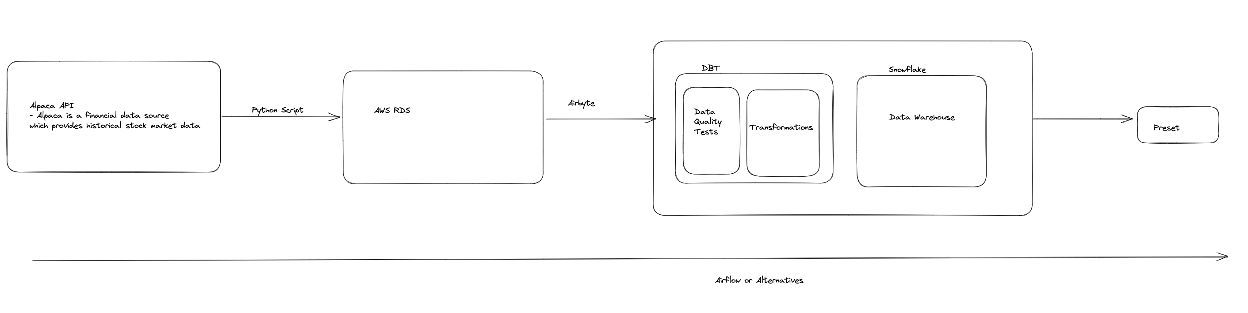
Data Architecture

Slide 4
Reason for Writing Custom Python Script
Had the intention to do quite a number of customization which could not be done with Airbyte but could be done with customized ETL code.
Wanted to connect the Postgres DB to an actual UI interface to allow user to change the inputs (which I did not have time to complete)

Slide 5
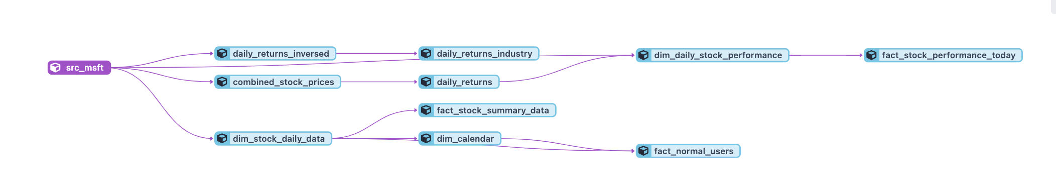
Dataset
Live dataset
Full extract of 30 days worth of data (supposed to be 1 year) on the first extraction
Incremental extract of 1 day worth of data each time subsequently
Had to do some pretty crazy transformations to make the dataset into something useful

Slide 6
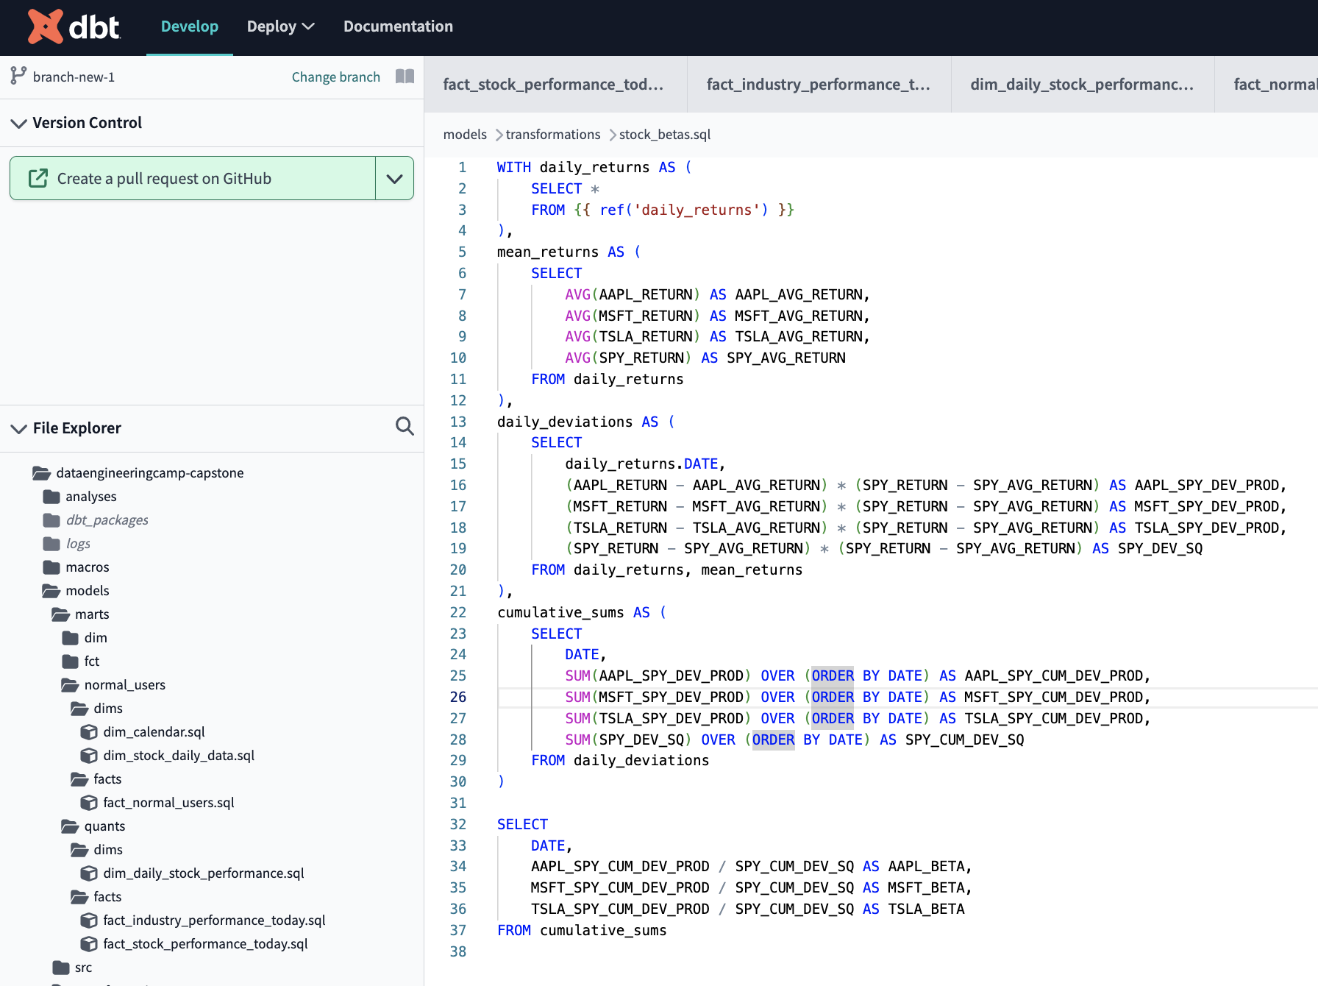
DBT Cloud
Allows you to do pull request directly
Debugging is a hassle and the UI is not intuitive
Nonetheless, easy to set up
Easy to deploy
Allows for direct scheduling

Slide 7
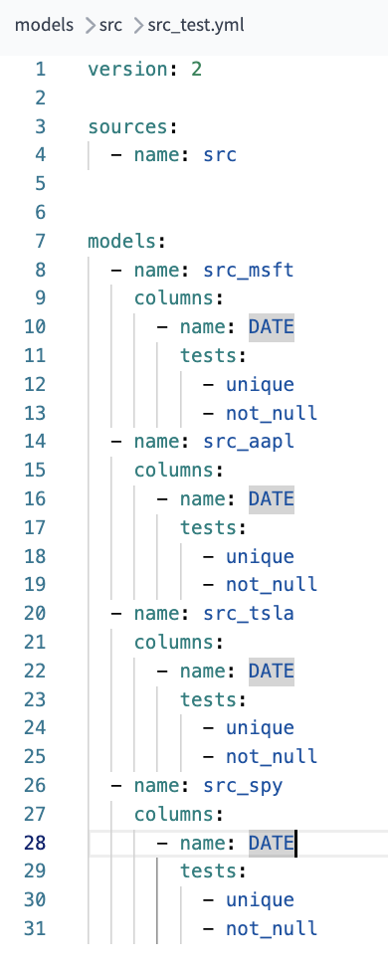
DBT – DBT tests
DBT tests
Did some simple tests only
Did testing on the Date column mostly because I used it as the primary key

Slide 8
DBT – DBT Transformations
Lots of transformations were done
Will just go through the most difficult one which is Beta

Slide 9
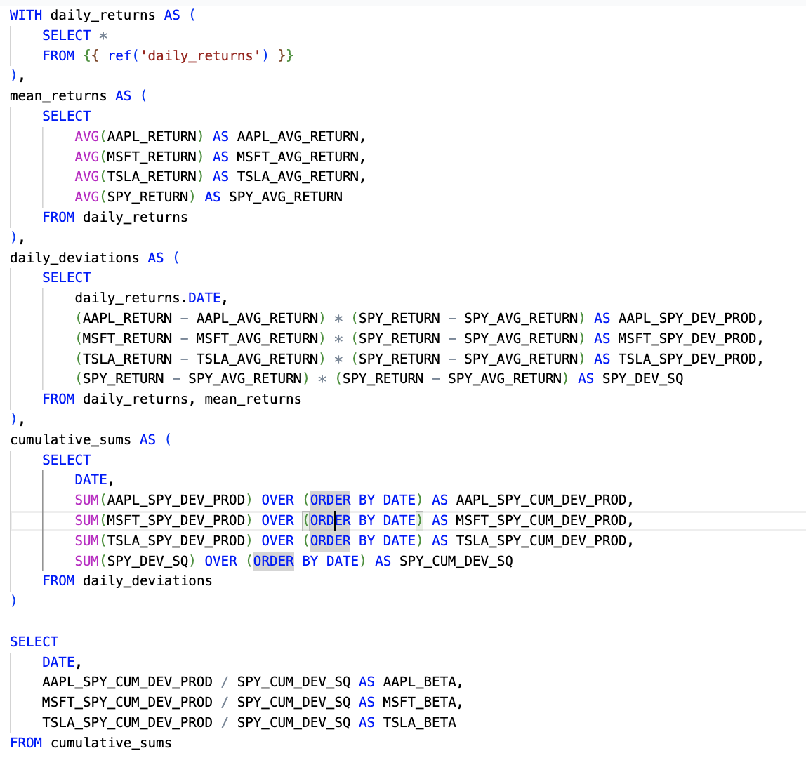
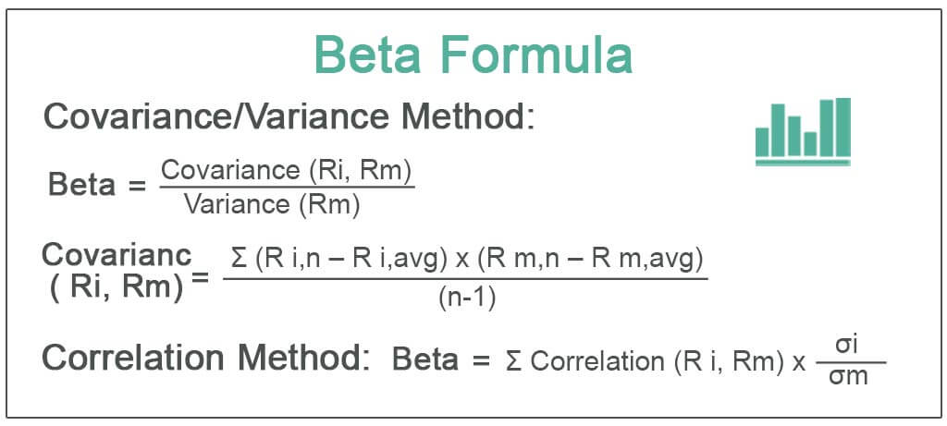
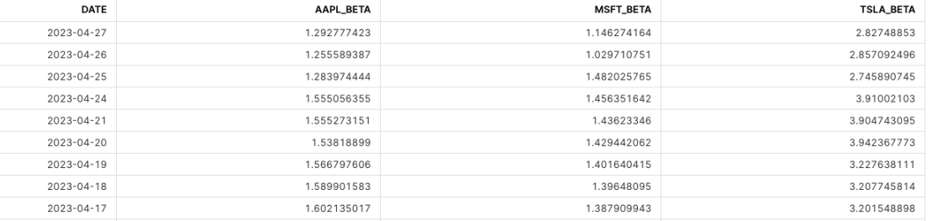
Beta
Explanation:
Beta is a concept that measures the expected move (volatility) in a stock relative to movements in the overall market (or referenced index).
A beta greater than 1.0 suggests that the stock is more volatile than the broader market,
and a beta less than 1.0 indicates a stock with lower volatility.
Volatility is also seen as risk in finance
Reference index is SPY (S and P 500) in this case
TSLA has the highest beta (volatility), and thus is the riskiest stock in this basket of stocks

Slide 10
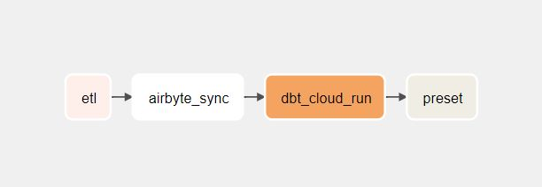
Data Orchestration (Airflow)
Pros
Relatively easy to use and nice to have just one dashboard and diagram for all the tasks.
Cons
Using Airflow in this use case is an overkill, not to mention pretty expensive (requires t2.medium in dev and t2.large in prod)

Slide 11
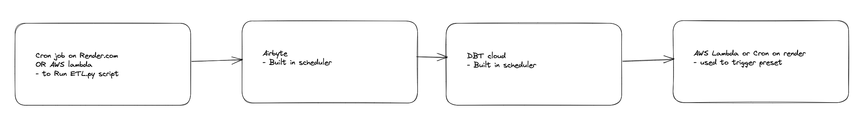
Data Orchestration (Non Airflow Alternative)
Pros
No additional cost (except for aws lambda or cron which is very cheap)
Cons
Need to set things up individually
Preset does not have a built-in scheduler or a built-in trigger function, but it can be integrated with external scheduling tools and trigger systems such as Apache Airflow, cron, and AWS Lambda.

Slide 12
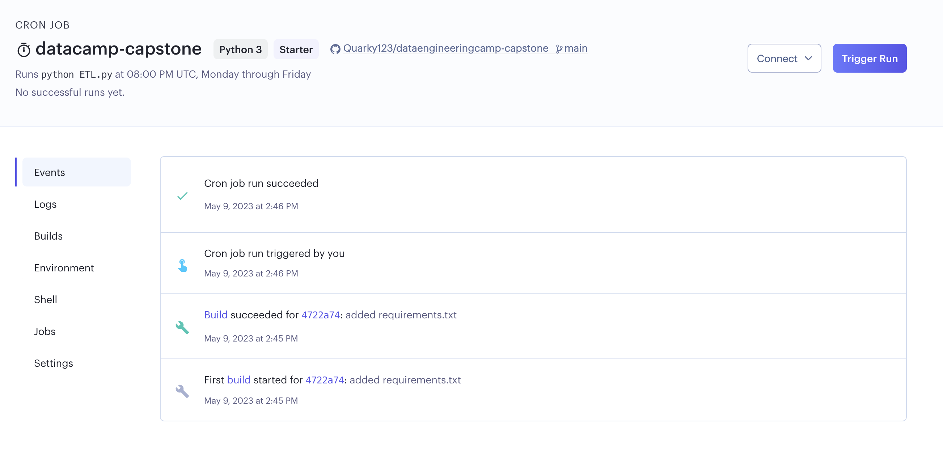
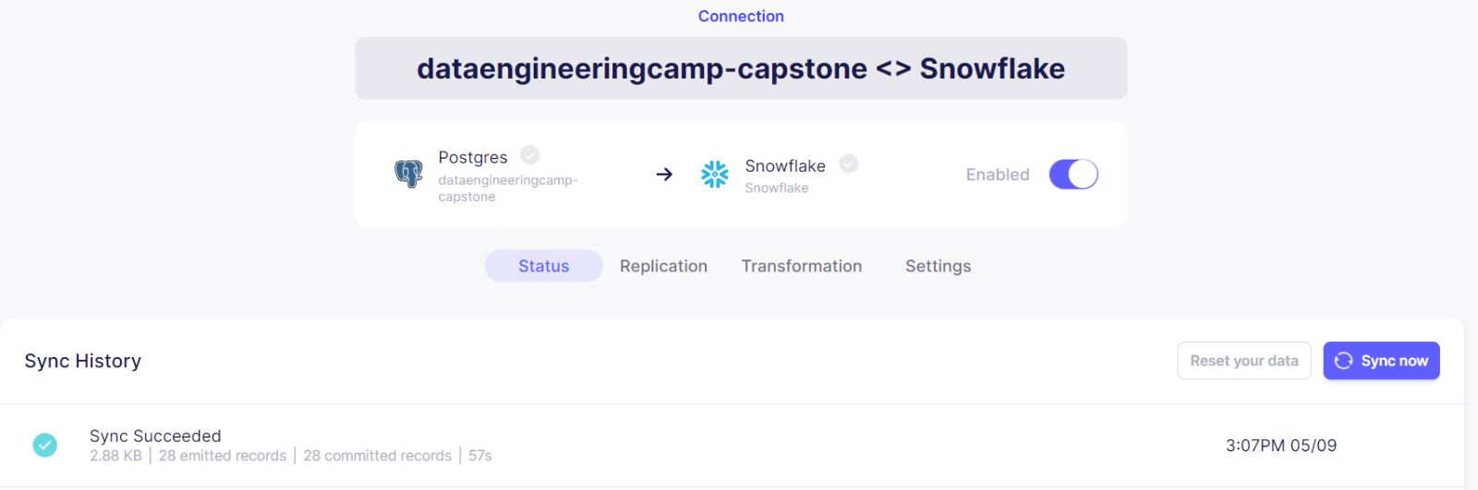
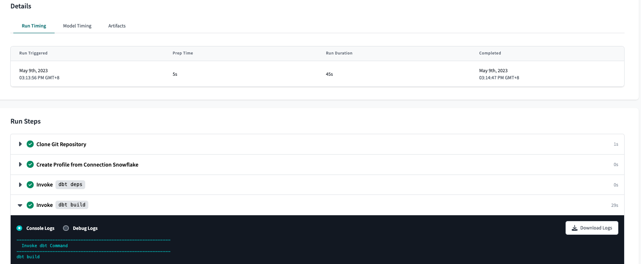
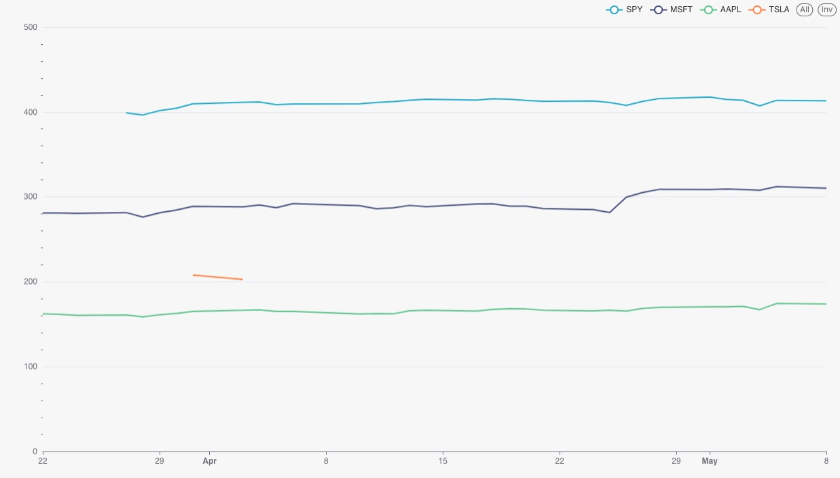
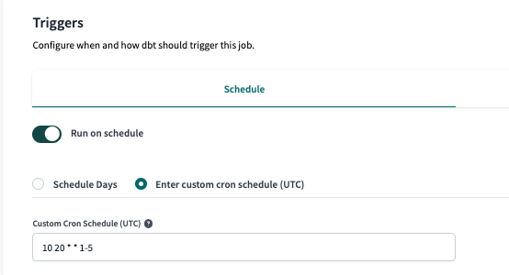
Python ETL
CRON Jobs
0 20 * * 1-5
Runs python ETL.py at 08:00 PM UTC, Monday through Friday
0 5 20 * * 1-5
Runs AIRBYTE at 08:05 PM UTC, Monday through Friday
10 20 * * 1-5
Runs DBT Cloud at 08:10 PM UTC, Monday through Friday
15 20 * * 1-5
Runs ETL.py at 08:15 PM UTC, Monday through Friday
Cron not needed for Preset if you’re just using the preset interface when you need it
AIRBYTE
DBT cloud scheduler
Preset
DBT Cloud

Slide 13
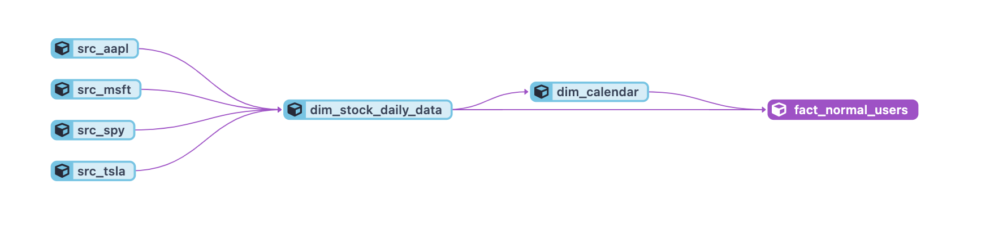
Dimensional Models – For Normal Users
Explanation:
For users who just want to know about the date and the stock movement that day

Slide 14
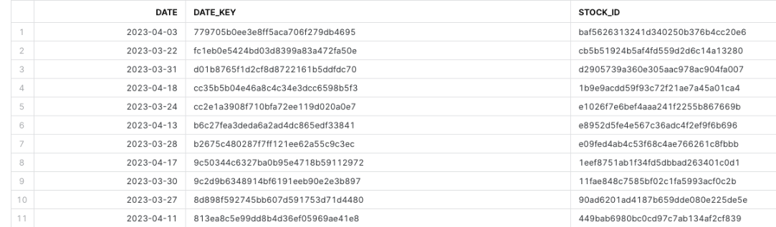
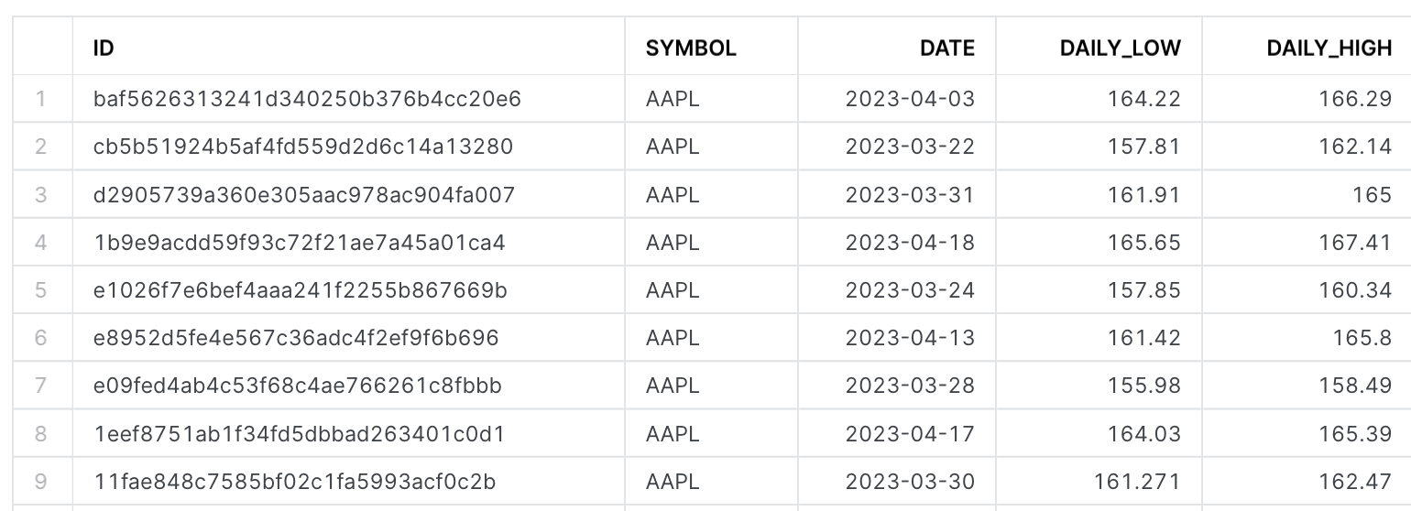
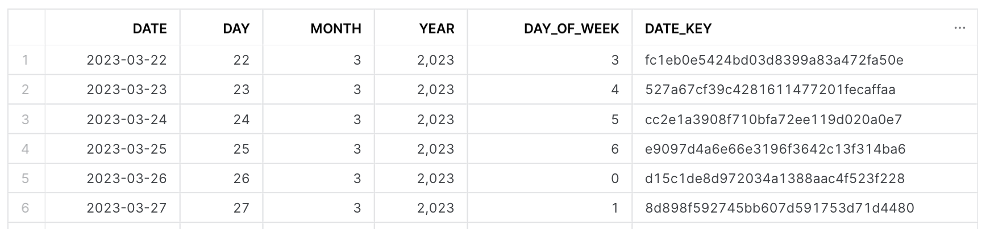
Fact_normal_user
Dim_stock_daily_data
Dim_calender

Slide 15
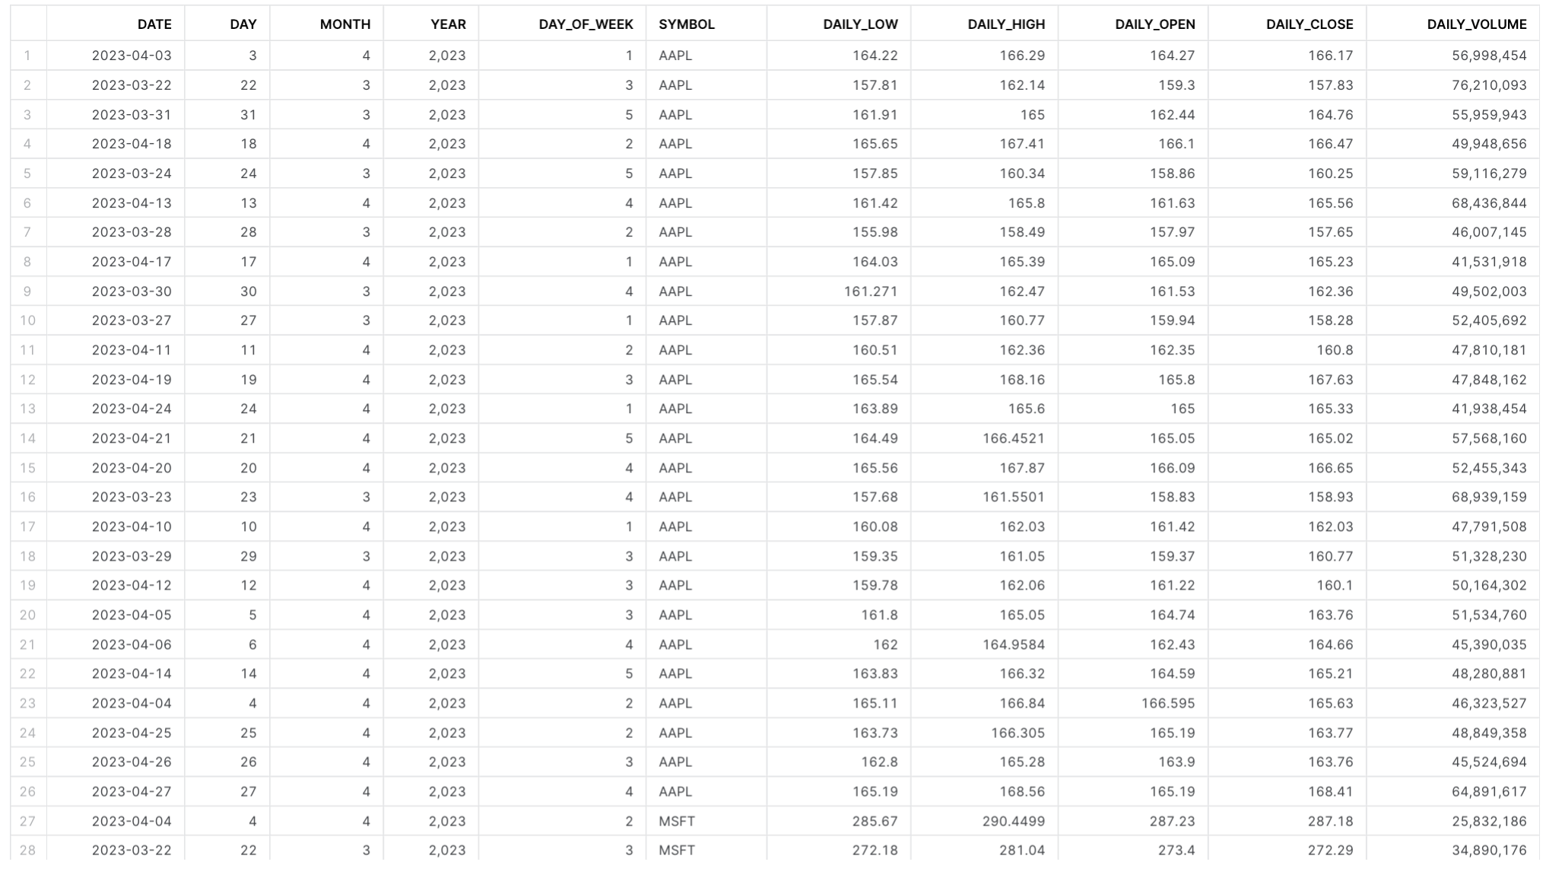
OBT_normal_user (one big table)

Slide 16
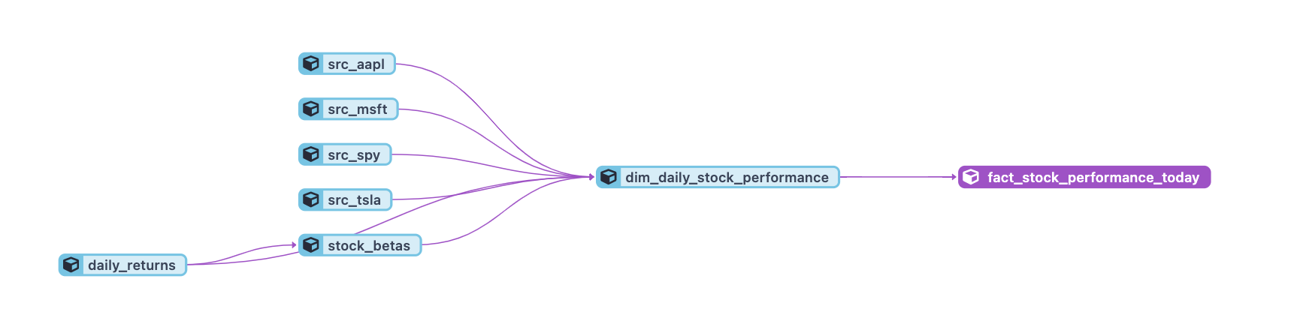
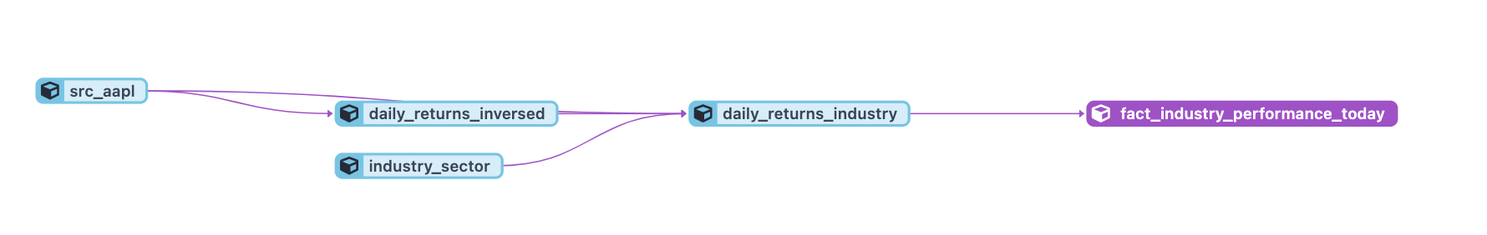
Dimensional Models – For Quants
Explanation:
For Quant users who wants to do some more advanced analysis, the data is already prepared for them

Slide 17
Visualization / Preset
Average Daily High

Slide 18
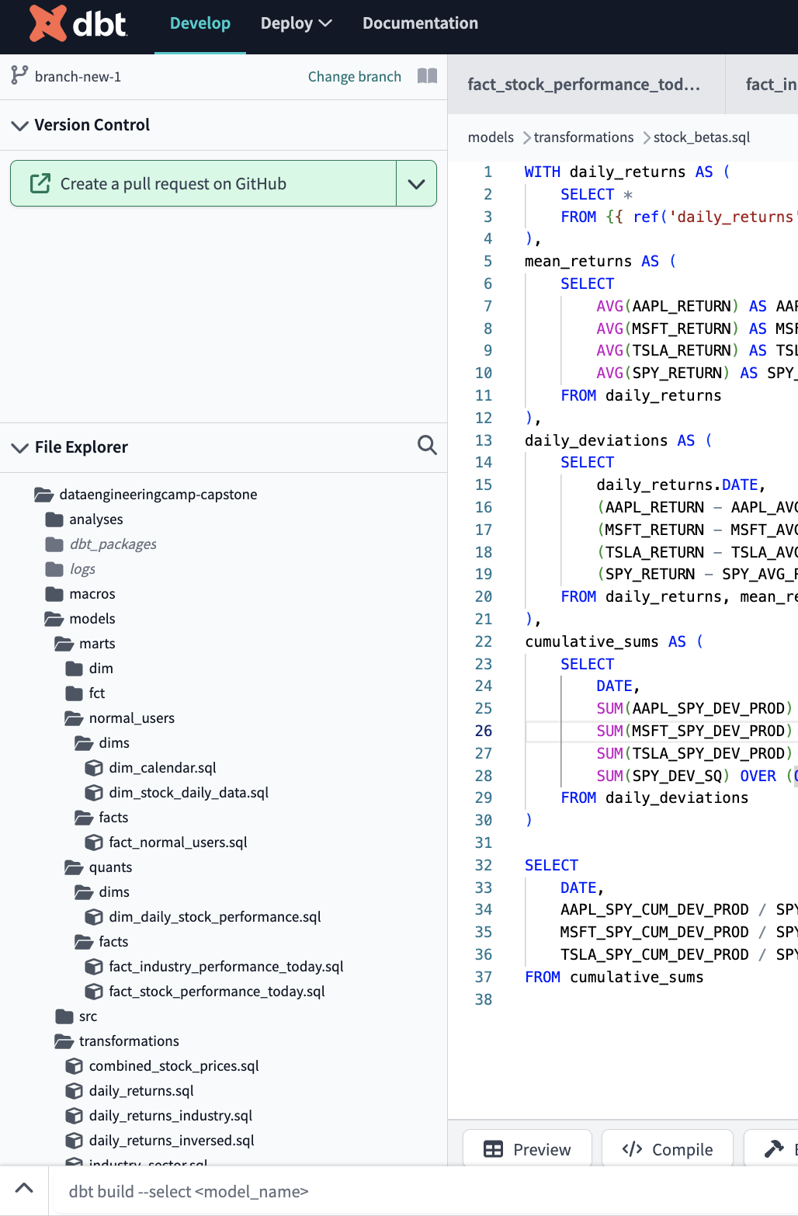
Lesson Learnt
Dataset selection is very important
I selected a live time series dataset that has limited descriptive tables beyond the stock price data
Really hard to work with as I need to do a lot of transformations on my own to generate more tables and gain more insights
DBT cloud is a headache to work with
Almost no tutorials on DBT cloud about their UI
Example: Tried to figure out how to debug for days, turns out its at the bottom left corner with no description at all
You also can only run DBT test 1 model at a time on the IDE (you can run all if you go to jobs)
Beyond that its actually pretty good.
Ideal for people who do not want to set up anything on your computer
Set up Snowflake RBAC correctly the first time
This is the CLI

